Slide 1
Zoom – Intent
Shay nikles
loc. 101

Slide 2
Zoom – Intent
WIIFM
“WHAT’S IN IT FOR ME”
More contacts
More appointments
More signatures
More money
Using Zoom Intent shows you EXACTLY what a company is searching for.
Wouldn’t it be nice to phone block and mention the products
and services a business needs, WHILE they’re looking for it online?

Slide 3
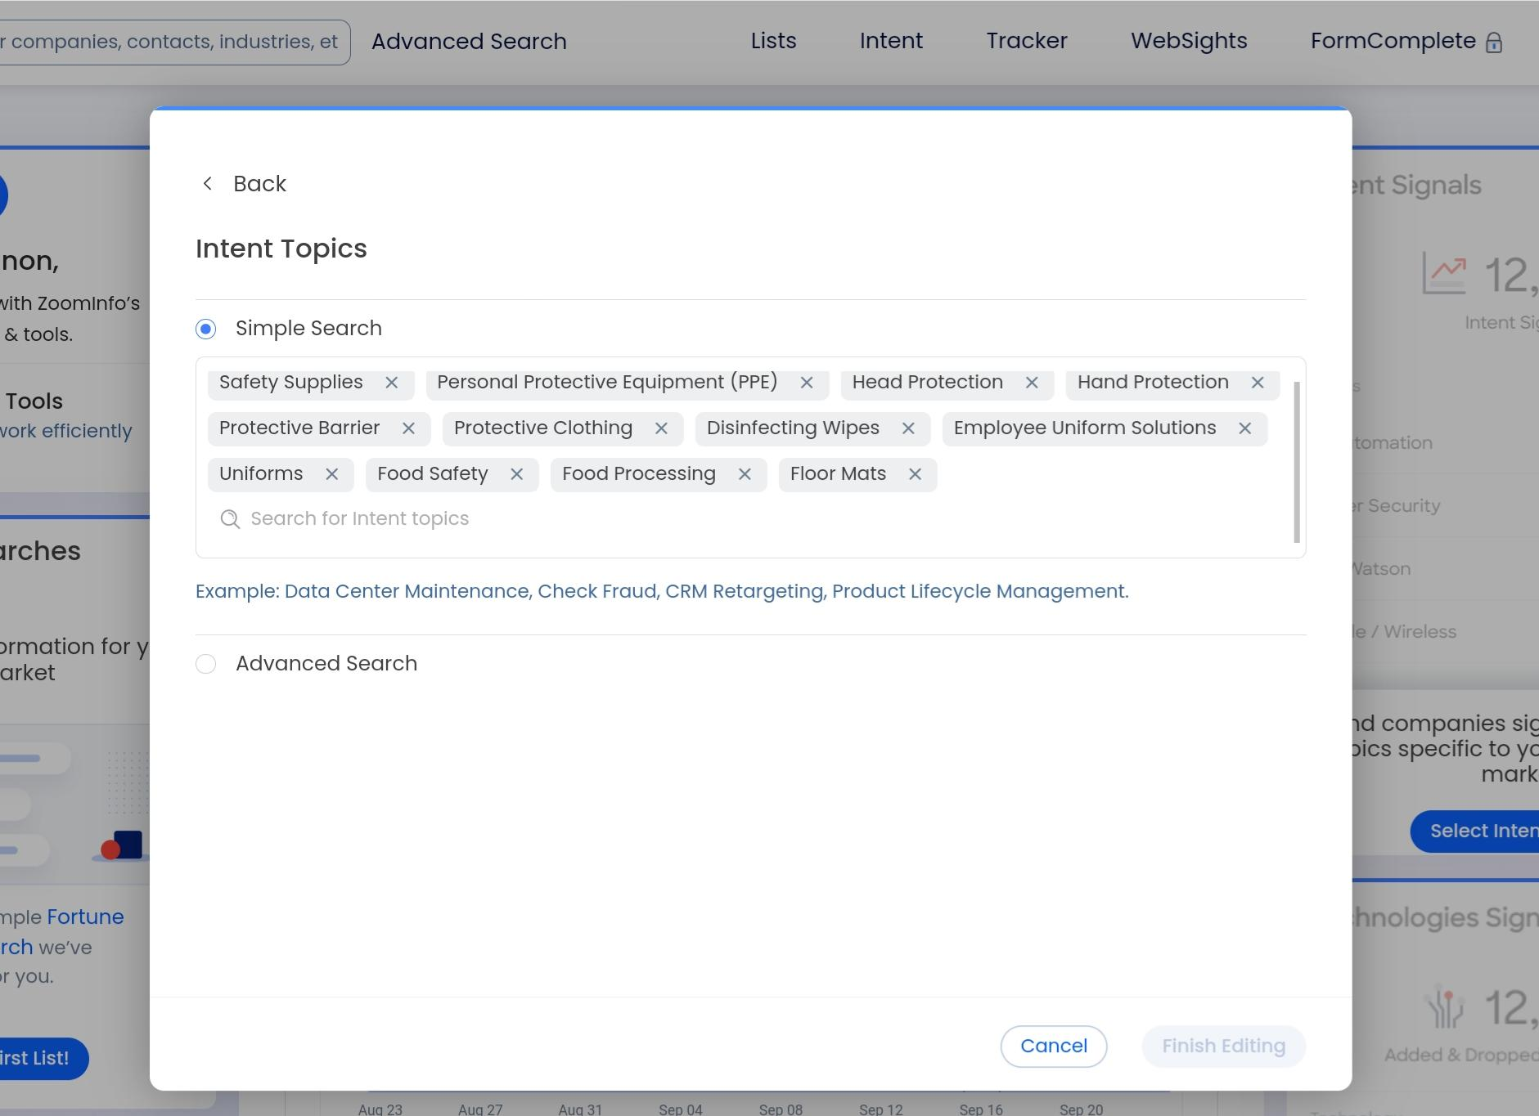
Sign in to Zoominfo.com
Manage Your Feed
Intent Topics
Search & Choose topics

Slide 4
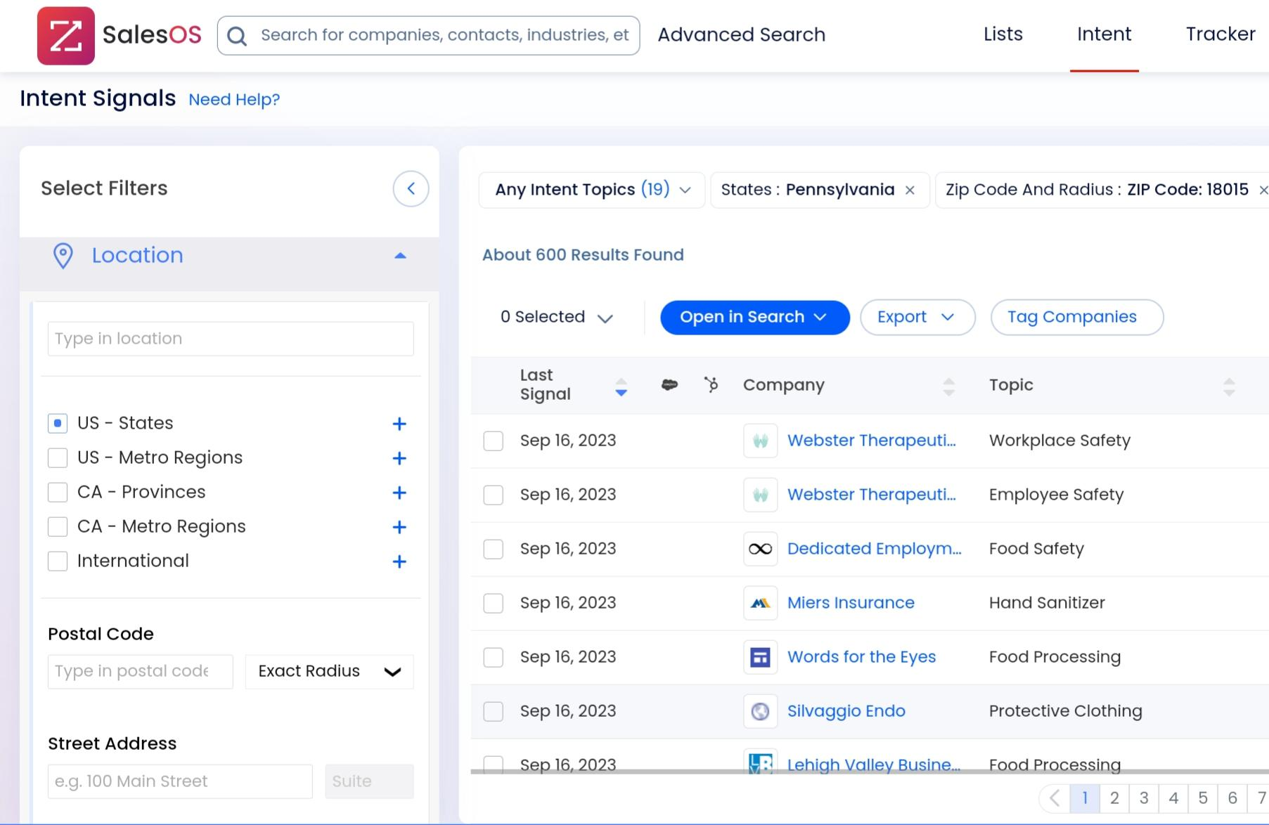
Click on Intent Tab
Enter zip codes if not set up through your profile

Slide 5
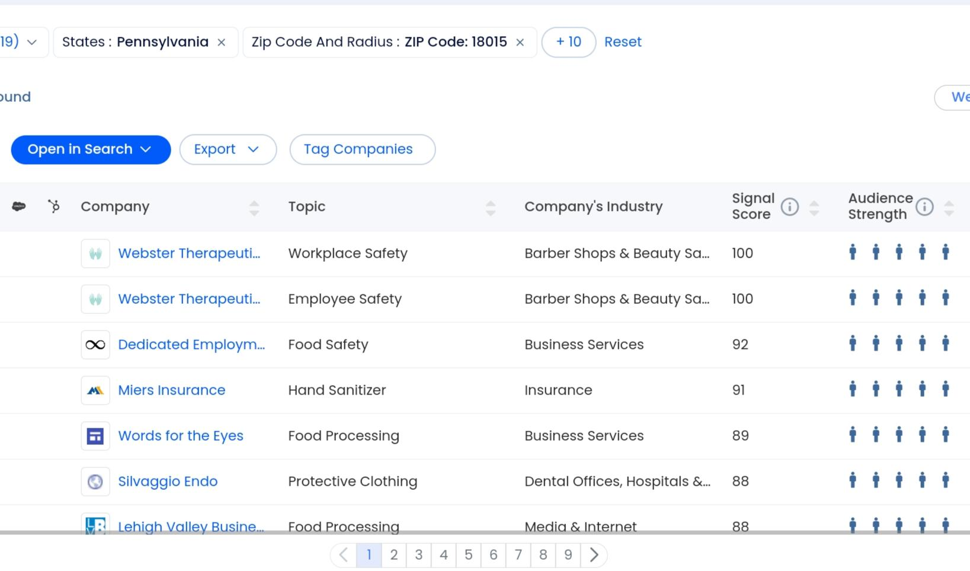
Deep Dive Views
    Signal Strength & Audience Strength
    9 pages of data
    Industry confidence

Slide 6
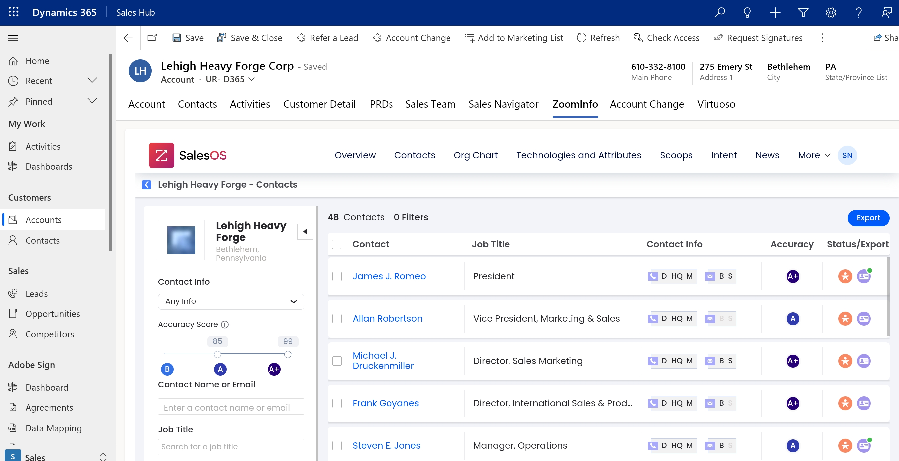
Open Dynamics
Find Account
Export contacts
directly from Zoom
by using the purple
business card

Slide 7
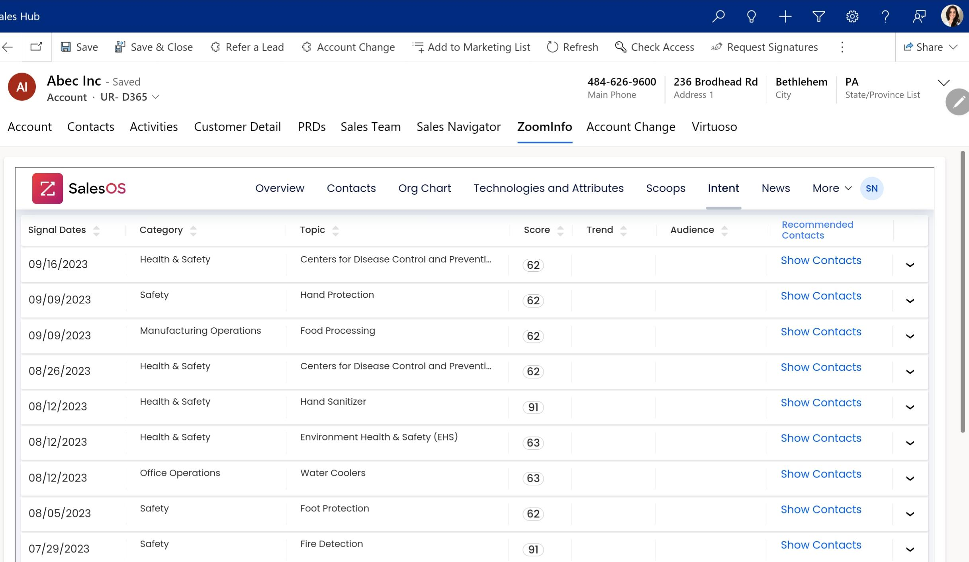
Dynamics View
    Intent Tab shows a
    full history of your
    topics within your
    Dynamics screen now
    Recommended contacts

Slide 8
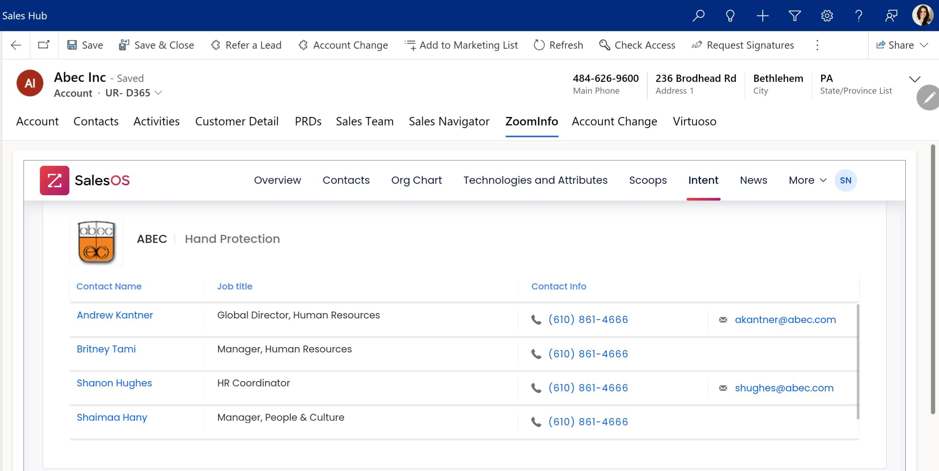
Recommended
contacts sorted
by topic

Slide 9
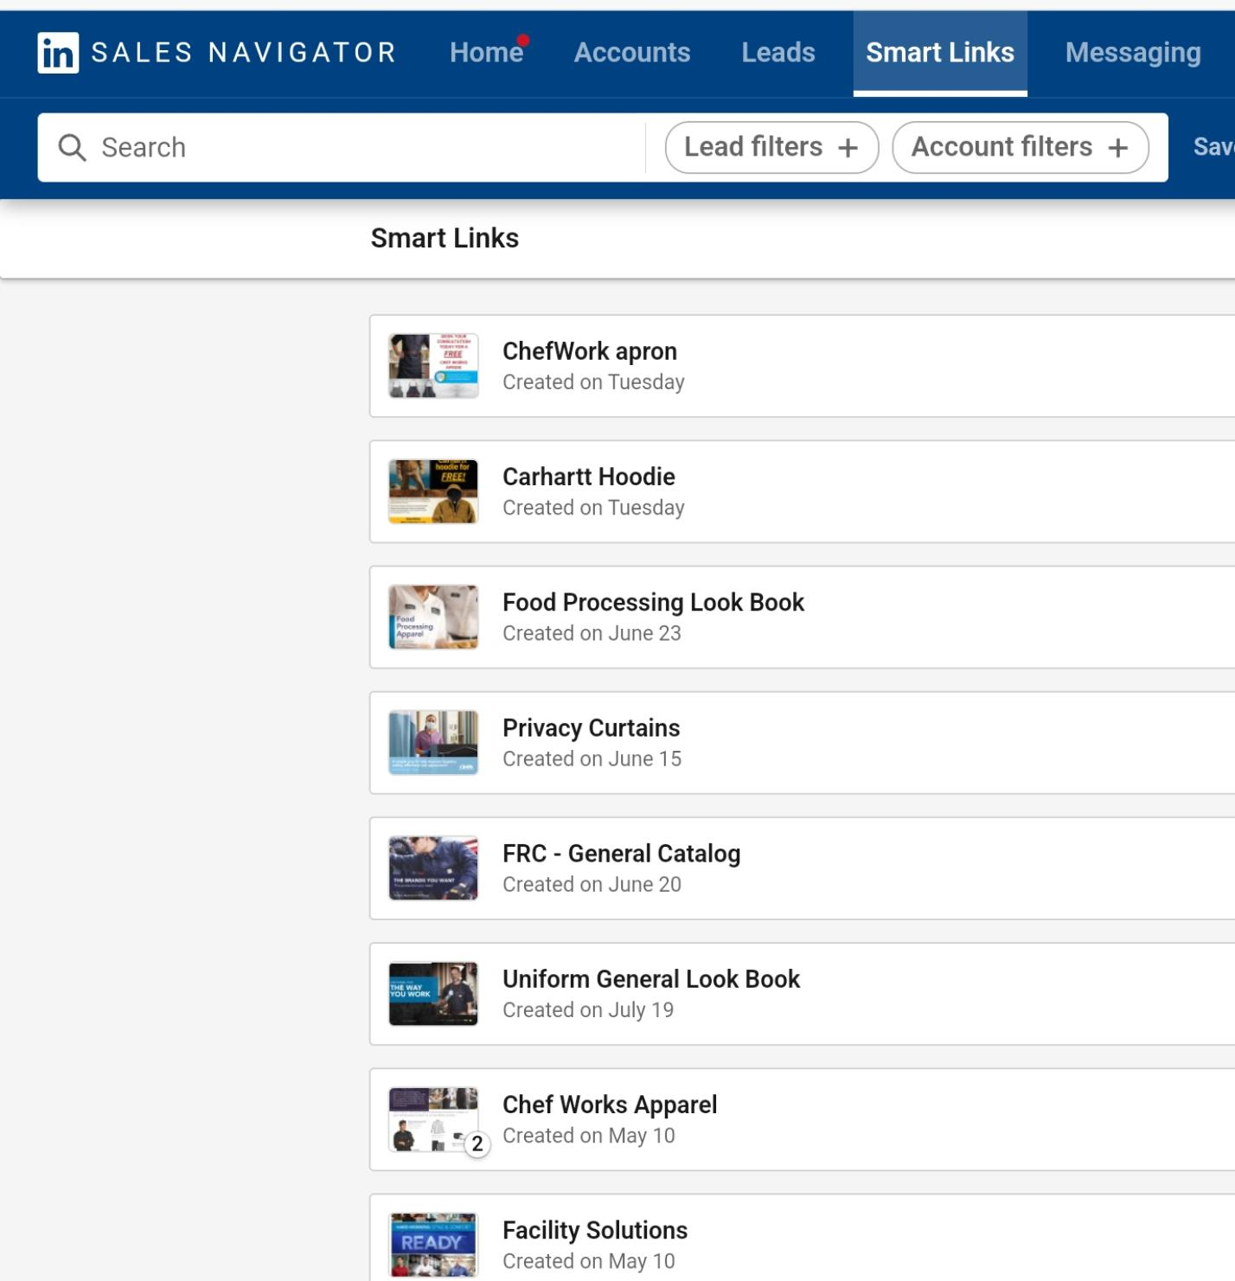
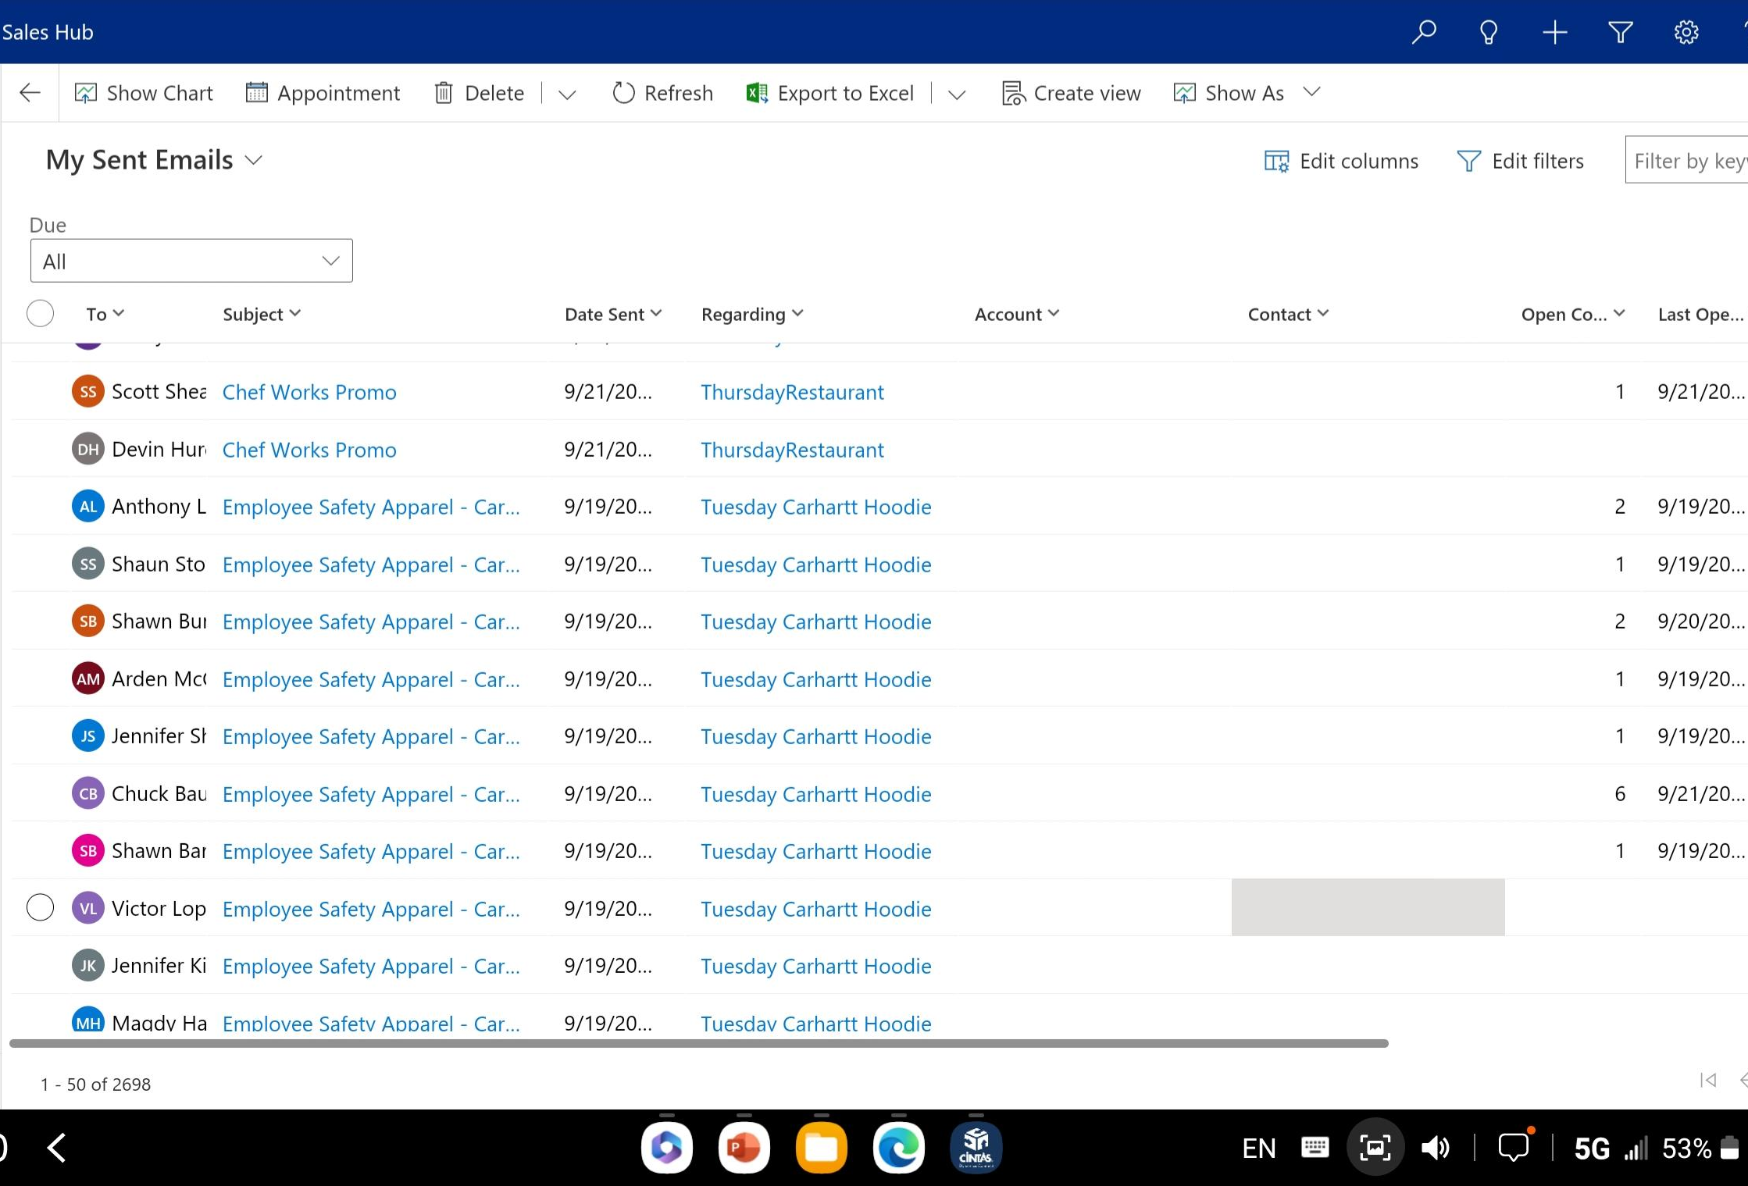
What do I do now?
PHONE BLOCK
CONNECT ON LINKEDIN
SEND NAVIGATOR MESSAGE
E SEEDS
PERSONAL EMAIL
SMARTLINK E SEED
BLACK BOX
OSV
WAVE SEED
CALL AGAIN
Zoom – Intent

