Slide 1

New Store Front’s
THE WHOLE PIE
FS SALES SKILLS
SHAY NIKLES
LOC 101

Slide 2



Shay Nikles
FS SALES CAPTAIN
101 ALLENTOWN
UNIFORM FY ’24
DIAMOND LEVEL FY ’22
PRESIDENT’S CLUB FY ’21
ROOKIE OF THE YEAR FY ’21
TECH CHAMP
610.216.5534
NiklesS@cintas.com

Slide 3
The Whole Pie
WHY DON’T WE HAVE THE NEW STORE FRONT COUNTS?
WHAT INDUSTRIES ARE WE TALKING TO?
ARE WE USING THE BEST HOOK AND CLOSING IT ON THE SPOT?
ARE YOUR PROSPECTING/SELLING/INSTALLING ROUTINES HEALTHY ENOUGH TO SUPPORT 2-3 NSF’S A WEEK?
WHAT’S IN IT FOR ME?

Slide 4
Why don’t we have the nsf’s?
LET’S TALK ABOUT IT.
NOT PRESENTING TO THE MAIN DECISION MAKER
NOT ASKING FOR THE BUSINESS AFTER BUILDING ALL THE PAIN
NOT ENOUGH QUALIFIED APPOINTMENTS EACH WEEK
NOT SELLING THE VALUE ENOUGH - BUNDLE, BUNDLE, BUNDLE!
NEEDING A STRONGER FOLLOW UP PLAN

Slide 5
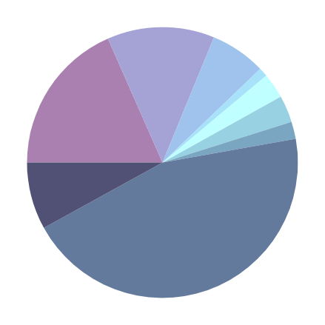

What industries are we talking to?
LIST OUT POPULAR INDUSTRIES WE’RE TARGETING HERE
MY TRAX
FREIGHT = $601
RESTAURANTS = $861
DEALERSHIP = $308
FOOD PRO = $47
GYM = $141
RECOVERY CENTER = $151
ELECTRICIAN = $96
WAREHOUSES = $375
MANUFACTURING = $2,597

Slide 6
Where else should we go?
Dentists | Surgery Centers | Eye Care | Property Management Groups
Apartment Buildings | Gas Stations | Real Estate Offices |
Commercial Show Room |Laundromats | Funeral Homes | Salons | Nursing Homes |Cleaning Companies | Bakeries | Coffee Shops | Med Spas | Assisted Living | Rehabilitation Centers | Churches | Salvation Armies | Physical Therapy | Metal Fabrication | Wellness Centers
Notaries | Insurance Companies | Wealth management Offices | Corporate Head buildings | Manufacturing | Logistics | Hotels |
Restaurants | Fitness Clubs | Gyms | Daycares

Slide 7
What’s the hook?
LET’S TALK ABOUT IT.
PICK 3-5 INDUSTRIES AND LET’S DISCUSS THE BEST HOOK
FOOD PROCESSING - MICROFIBER & HYGIENE
RESTAURANTS - MATS, TOWELS, APRONS
SALONS - BRANCH & VINE, BATH TOWELS
MANUFACTURING - SHOP TOWELS, WELLNESS MATS, CAN LINERS
NURSING HOMES - AIR FRESHENERS, CHEMICALS, PULSE MOPS

Slide 8
Pizza Making Time!
Grab your Trax
The crust and sauce are your territory
Cheese is YTD volume
Toppings = industries sold so far
Break down your volume by industry and build your pizza.
How many toppings do you get to add?

Slide 9
WIIFM
INCREASE IN NSF = INCREASE IN MONEY MADE, RECOGNITION, PRESIDENT CLUB RANKINGS, PROMOTION OPPORTUNITIES.
SUSTAINED SUCCESS MODEL & EFFORT VS. SKILL
NEW PRESENTATIONS X CLOSING RATIO X AVERAGE ACCOUNT SIZE
MORE INDUSTRIES WILL LEAD TO MORE PRESENTATIONS!

